Slide 1
C++ lecture
Chapter two : Expression Assistant lecture: Jinan N. Shihab
Statement :-
A statement is a complete instruction asking the computer to carry out some tasks.
Normally written one per line, although some statements span multiple lines.
Always end with a semicolon ( ; ).
For example: x = 2 + 3;
An expression is any computation which yields a value. When discussing expressions, we often use the term evaluation. For example, we say that an expression evaluates to a certain
value.
operators:-
C++ is very rich in built-in operators. An operator is a symbol that tells the compiler to perform specific mathematical or logical manipulations. There are four general classes of
operators in C: arithmetic, relational, logical, and bitwise. In addition, there are some special operators for particular tasks and provides the following types of operators:
Arithmetic Operators
Relational Operators
Logical Operators
Assignment Operators
Increment & Decrement Operators
Bitwise Operators
Misc Operators
2-1-1 Arithmetic in C++
Arithmetic expressions can be made up of constants, variables, operators and parentheses. The arithmetic operators in C++ are as follows:-
Operator | Name | Example | Result
+ | Addition | 5+5.5 | 10.5
- | Subtraction | 5.67-10 | 4.33
* | Multiplication | 2*2.4 | 4.8
/ | Division | 8/5 | 1
% | Remainder | 8%5 | 3
NOTE: The % operator may appear ONLY with integer values.
When expressions are evaluated, they are evaluated left to right according to the following precedence rules:
1) ( ) 2) * / % 3) + -

Slide 2
C++ lecture
Chapter two : Expression Assistant lecture: Jinan N. Shihab
The expression 4 + 8 / 2 is evaluated as follows: 4 + 8 / 2 = (division has the highest precedence) 4 + 4 = 8
The expression (4 + 8) / 2 is evaluated as follows:
(4 + 8) / 2 = (parentheses have the highest precedence) 12 / 2 = 6.
The expression 8 % 3 is evaluated as follows: 8 % 3 = 2 (the whole number remainder)
The expression 8 % 3.0 would be invalid (3.0 is a floating point value and therefore not valid), as would the expression 8.0 % 3.
Example:- write C++ program to print the result of z=(a+b*b-3)/4*a using static cast <type>() operator?
# include <iostream.h> int main()
{
int a,b; \\ a and b declaration float z; \\ z declaration
cout<< "pls enter a,b values”<<endl;
cin>> a>>b; \\ enter a and b values.
z= (float)(a+b*b-3)/4*a; \\ calculate z value as float. Cout<<"z="<<z<<endl;
cout<<"z="<< static_cast<int>(z); \\ print the integer values of z return 0;
}

Slide 3
C++ lecture
Chapter two : Expression
Assistant lecture: Jinan N. Shihab
2-1-2 Relational Operators:-
The relational operators are used to test the relation between two values. All relational operators are binary operators and therefore require two operands. A relational expression returns zero when the relation is false and a non-zero when it is true. The following table shows the relational operators:-
Operator | Name | Example | Result
== | Equality | 6==6 | 1(true)
!= | Inequality | 6!=6 | 0(false)
< | Less than | 6<6.25 | 1(true)
<= | Less than and equal | 6<=6 | 1(true)
> | Greater than | 6>6 | 0(false)
>= | Greater than and equal | 6.5>=6 | 1(true)
The operands of relational operator must evaluate to a number, not char actors since it represent a numeric value, and the relational operators should not be used for comparing strings because this will result in the string addresses being compared.
Example: Write an expression to test if a number ( n) is even. Solution:- n%2==0
2-1-3 Logical Operators:-
In the term relational operator the word relational refers to the relationships values can have with one another. In the term logical operator the word logical refers to the ways these relationships can be connected together using the rules of formal logic. Then the logical operators are used to combine one or more relational expression. The following table shows the logical operators.
Operator | Name | Example | Result
&& | Logical And | 4<6&& 5<=5 | 1
|| | Logical Or | 3>2 || 2<4 | 1
! | Logical Negation or not | !(1==1) | 0
Logical And (&&) will execute the statement if and only if both of the simple conditions are true. If either or both of the simple conditions are false, then the program will skip the statements and proceeds to the statements followed.

Slide 4
C++ lecture
Chapter two : Expression Assistant lecture: Jinan N. Shihab
Logical Or (||) will execute the statement if either or both of two conditions are true. If both of the simple conditions are false, then the program will skip the statements and proceeds to the statements followed.
Logical negation ! is a unary operator, and it will execute the statement if the condition is
false and will skip the statement if the condition is true.
P | Q | p && q | p || q | !p
False | False | False | False | True
False | True | False | True | True
True | True | True | True | False
True | False | False | True | False
Both the relational and logical operators are lower in precedence than the arithmetic operators. This means that an expression like 10 > 1 + 12 is evaluated as if it were written 10
> (1 + 12). The result is, of course, false. Several operations can be combined in one expression, as shown here:
10>5 && !(10<9) || 3<=4 (which will evaluate true).
Example: Write an expression to test if a character (c) is a digit.
Solution: c >='0' && c <= '9'
Example: Write an expression to test if a character c is a letter.
Solution: c >= 'a' && c<= 'z' || c >='A' && c <='Z'
Example: Write an expression to test if n is odd and positive or n is even and negative.
Solution: n%2 !=0 && n>= 0 || n%2 == 0 && n<0
2-1-4 Assignment operators:-
The assignment operator ‘=’ stores the value of the expression on the right hand side of the equal sign to the operand on the left hand side. Examples a=5;
This statement assigns the integer value 5 to the variable a. the part at the left of the assignment operators (=) is known as the lvalue (left value) and the right one as the rvalue (right value). The most important rule when assigning is the right-to-left rule. The
assignment operation always takes place from right to left, and never the other way. The Assignment operator are summarized in table below:-

Slide 5
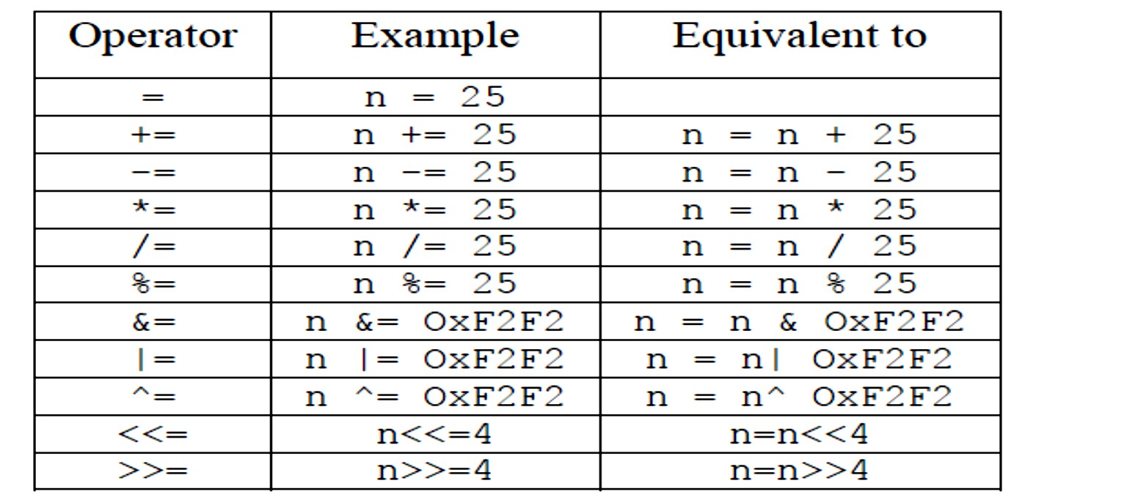
C++ lecture
Chapter two : Expression
Assistant lecture: Jinan N. Shihab
Example: Illustrate use of the assignment operators? Solution:
# include <iostream.h>
int main ()
{
int i=5; int k=2; i /= k;
cout << " i is" << i << endl; int j=20;
j *=k;
cout << " j is" << j << endl; int m=15;
m%=4;
cout << " m is" << m << endl; return 0;
}
Example:
#include <iostream.h> int main(){
int a,b; a=10;

Slide 6
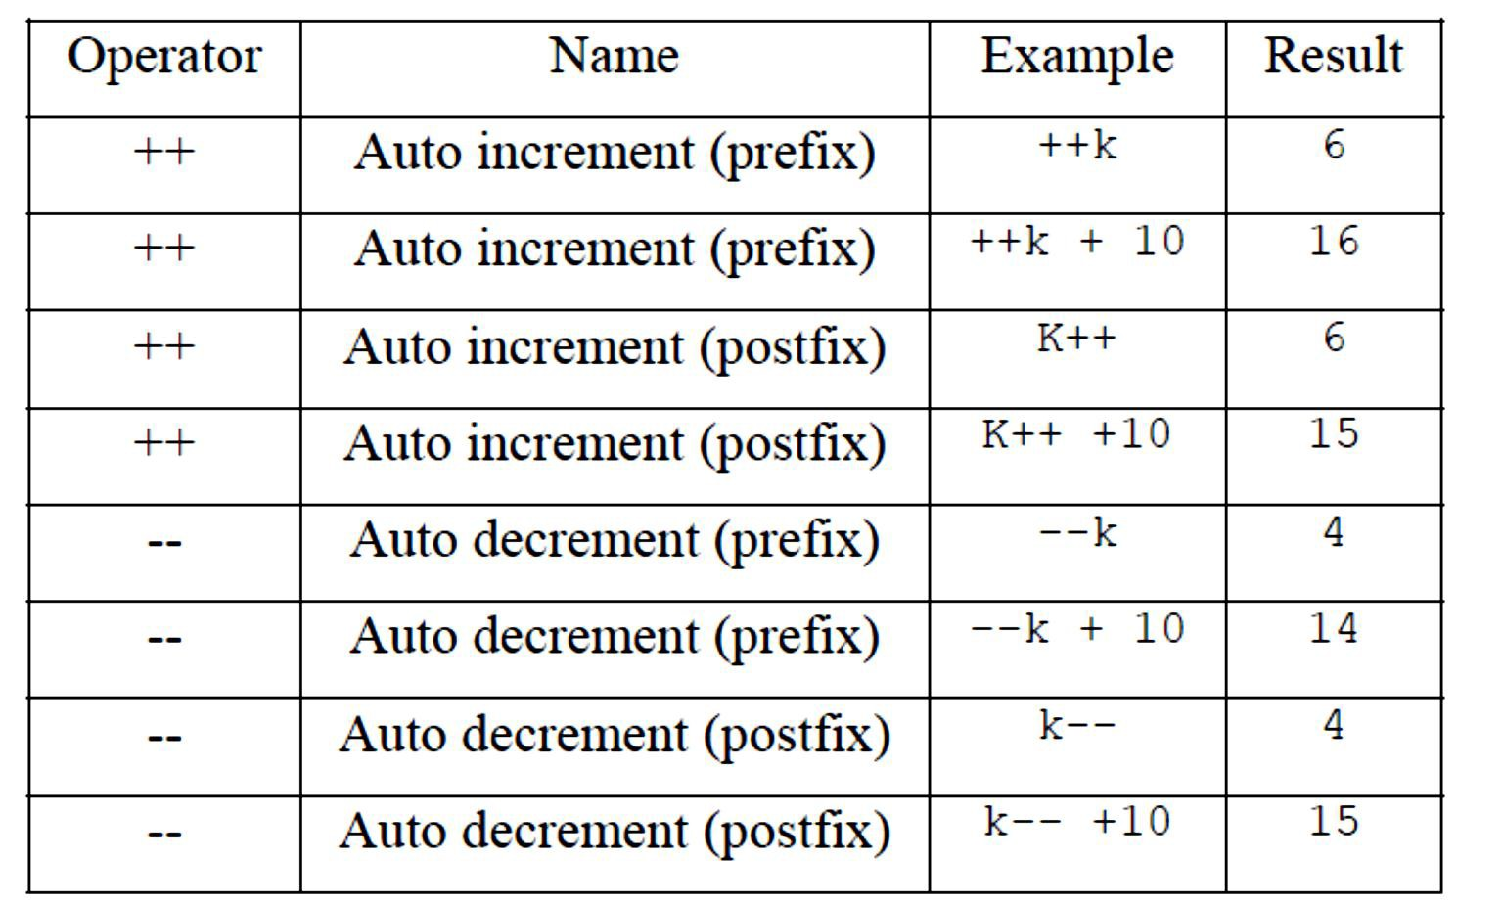
C++ lecture
Chapter two : Expression
Assistant lecture: Jinan N. Shihab
b=4;
a=b; b=7;
cout<<"a="<<a<<endl; cout<<"b="<<b<<endl; return 0;}
2-1-5 Increment & Decrement Operators:-
C++ allows two very useful operators not generally found in other computer languages. These are the increment and decrement operators, ++ and --. The operation ++ adds 1 to its
operand, and -- subtracts 1. Therefore, the following are equivalent operations:- int k=5; k=k+1
Example: write a C++ program to show the increment and decrement of the integer variable a=5;
# include <iostream.h> int main()
{
int a=5;
cout<<++a<<endl; // print 6
cout<<a++<<"\n"; // print 6 the icrement by 1 to become 7 at memory

Slide 7
C++ lecture
Chapter two : Expression
Assistant lecture: Jinan N. Shihab
cout<<++a<<"\n"; // here print 8
cout<<a++<<"\n"; // print also 8 but at the end store a=9 at memory cout<<a<< "\n"; \\ to check a=9
return 0;
}
2-1-6 Bitwise Operators:-
Unlike many other languages, C++ supports a complete complement of bitwise operators. Since C++ was designed to take the place of assembly language for most programming tasks, it needed the capability to support many operations that can be done in assembler. Bitwise operations are the testing, setting, or shifting of the actual bits in a byte or word, which
correspond to the standard char and int data types and variants. Bitwise operators cannot be used on type float, double, long double, void, or other more complex types. The bitwise
AND, OR, and NOT (one’s complement) are governed by the same truth table as were their logical equivalents except that they work on a bit-by-bit level. The exclusive OR ^ has the truth table shown here:
Q | p | q^p
0 | 0 | 0
0 | 1 | 1
1 | 0 | 1
1 | 1 | 0
The Bitwise operator:-
Operator | Action
& | AND
| | OR
^ | Exclusive OR (X-OR)
~ | One's complement
>> | Shift Right
<< | Shift lift
The shift operators, >> and <<, move all bits in a variable to the right or left as specified.
The general form of the shift right statement is
variable >> number of bit positions and the shift left statement is variable << number of bit positions.

Slide 8
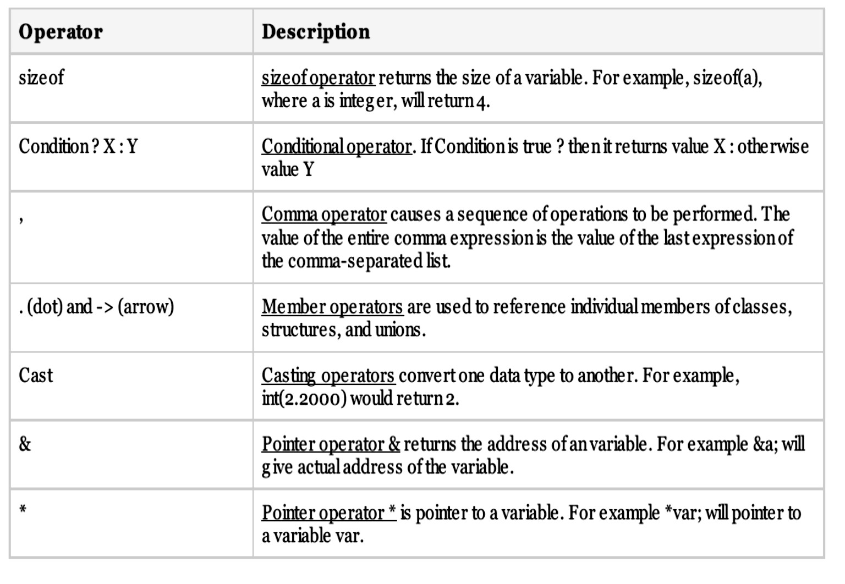
C++ lecture
Chapter two : Expression Assistant lecture: Jinan N. Shihab
Example:- write C++ program to input two values and using AND, OR, XOR, shift to lift by 2(N1) between them, then print the results?
Solution:-
#include <iostream.h> int main(){
const int N1 = 187; const int N2 = 242;
cout<<N1<<”&”<<N2<<”=”<< (N1 & N2)<<”\n”;
cout<<N1<<”|”<<N2<<”=”<< (N1 | N2)<<”\n”; cout<< N1<< “^” << N2<< “=”<< N1 ^ N2 <<”\n”;
cout << N1<<”<<2=”<<(N1<<2)<<”\n\n”;
return 0;
}
2-1-7 Misc Operators:-
There are few other operators supported by C++ Language

Slide 9
C++ lecture
Chapter two : Expression Assistant lecture: Jinan N. Shihab
Conditional operator
The conditional operator ?: is called ternary operator as it requires three operands. The format of the conditional operator is:
Conditional expression ? expression1 : expression2;
If the value of conditional expression is true then the expression1 is evaluated, otherwise expression2 is evaluated.
int x = 10;
y = x>9 ? 100 : 200;
Example:
int m= 1, n=2;
int min = (m<n ? m : n);
cout << min; // result min =1
Example:
int min = (m<n ? ++m : n++); // result min =2
m is incremented because ++m is evaluated but n is not incremented because n++ is not evaluated.
Example:
int x = 10, y = 5, z = 42;
int t = y > x ? z : z + 5; cout << t; // result t =47
Example: Write an expression to give the absolute value of a number n.
Solution: (n >=0 ? n: -n)
Comma operator
Multiple expressions can be combined into one expression using the comma operator. The comma operator takes two operands. It first evaluates the left operand and then the right operand, and returns the value of the latter as the final outcome,
Example:
int m, n, min;
int mCount = 0, nCount = 0;
min= (m < n ? mCount++, m : nCount++, n);
When m is less than n, mCount++ is evaluated and the value of m is stored in min. Otherwise, nCount++ is evaluated and the value of n is stored in min.

Slide 10
C++ lecture
Chapter two : Expression Assistant lecture: Jinan N. Shihab
2-1-7-3 Sizeof operator:-
As we know that different types of variables, constant, etc. require different amounts of memory to store them. The sizeof operator can be used to find how many bytes are required for an object to store in memory.
Example:
# include <iostream.h>
int main (void)
{
cout << "char size = " << sizeof (char) << " bytes\n"; cout << "char* size = " << sizeof (char*) << " bytes\n";
cout << "short size = " << sizeof (short) << " bytes\n"; cout << "int size = " << sizeof (int) << " bytes\n"; cout << "long size = " << sizeof (long) << " bytes\n"; cout << "float size = " << sizeof (float) << " bytes\n";
cout << "double size = " << sizeof (double) << "bytes\n"; cout << "1.55 size = " << sizeof (1.55) << " bytes\n";
cout << "1.55L size = " << sizeof (1.55L) << " bytes\n"; cout << "HELLO size = " << sizeof ("HELLO") << "bytes\n";
}
When run, the program will produce the following output (some small different values can be found on author PC.)
char size = 1 bytes char* size = 2 bytes short size = 2 bytes
int size = 2 bytes long size = 4 bytes float size = 4 bytes double size = 8 bytes
1.55 size = 8 bytes 1.55L size = 10 bytes HELLO size = 6 bytes
Simple Type Conversion:-
The process in which one pre-defined type of expression is converted into another type is called conversion. There are two types of conversion in C++.
Implicit conversion
Explicit conversion
10

Slide 11
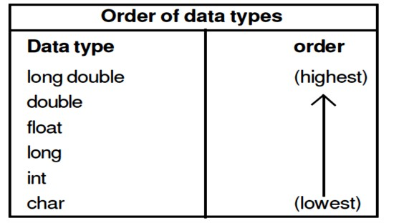
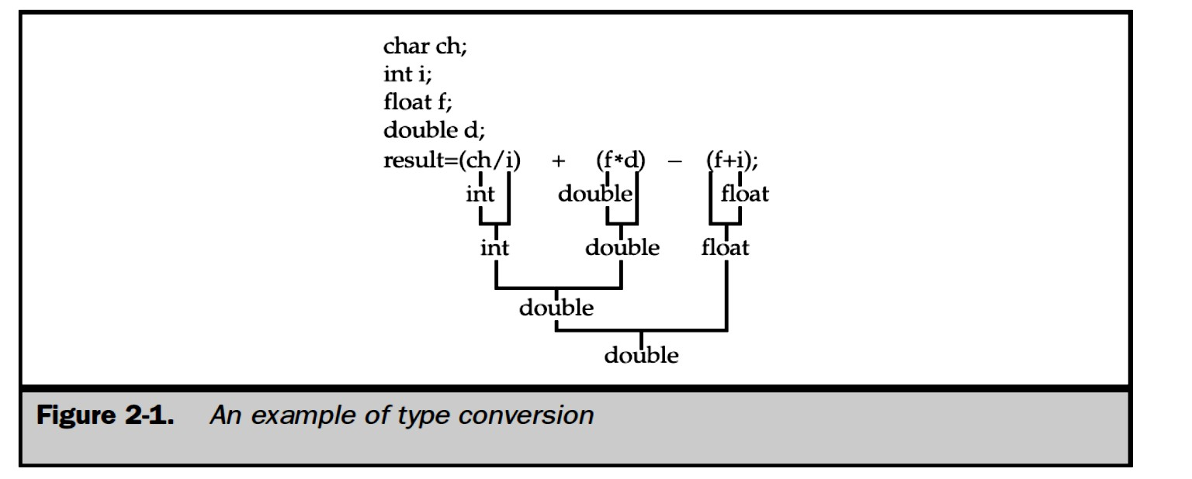
C++ lecture
Chapter two : Expression
Assistant lecture: Jinan N. Shihab
- Implicit conversion
Data type can be mixed in the expression.
Example:- double a; int b = 5;
float c = 8.5; a = b * c;
When two operands of different type are encountered in the same expression, the lower type variable is converted to the higher type variable. The following table shows the order of data types:-
The int value of b is converted to type float and stored in a temporary variable before being multiplied by the float variable c. The result is then converted to double so that it can be assigned to the double variable a.
- Explicit conversion:-
It is also called type casting. It temporarily changes a variable data type from its declared data type to a new one. It may be noted here that type casting can only be done on the right hand side of the assignment statement.
T_Pay = double (salary) + bonus;
Initially variable salary is defined as float but for the above calculation it is first converted to double data type and then added to the variable bonus.

Slide 12
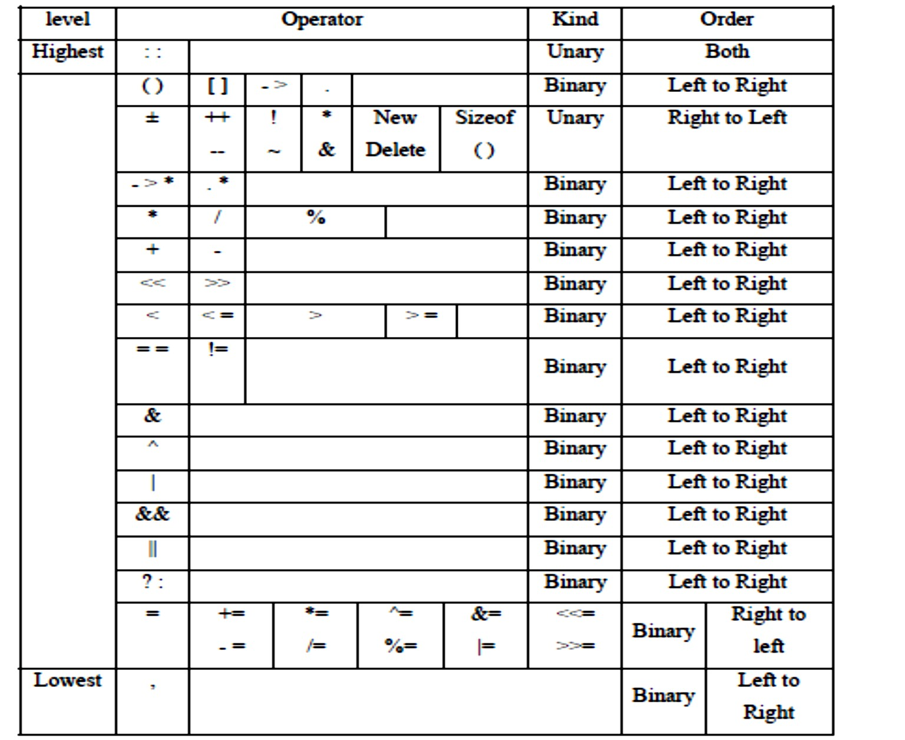
C++ lecture
Chapter two : Expression Assistant lecture: Jinan N. Shihab
When the result of an arithmetic operation exceeds the range of the variable's data type, an error called overflow occurs.
Example:-
int m, n, min;
int mCount = 0, nCount = 0;
min= (m < n ? mCount++, m : nCount++, n);
When m is less than n, mCount++ is evaluated and the value of m is stored in min. Otherwise, nCount++ is evaluated and the value of n is stored in min
2.2 Operator Precedence
The order in which operators are evaluated in an expression is significant and is determined by precedence rules. These rules divided the C++ operators into a number of precedence
levels (as table below). Operators in higher levels take precedence over operators in lower levels.

Slide 13
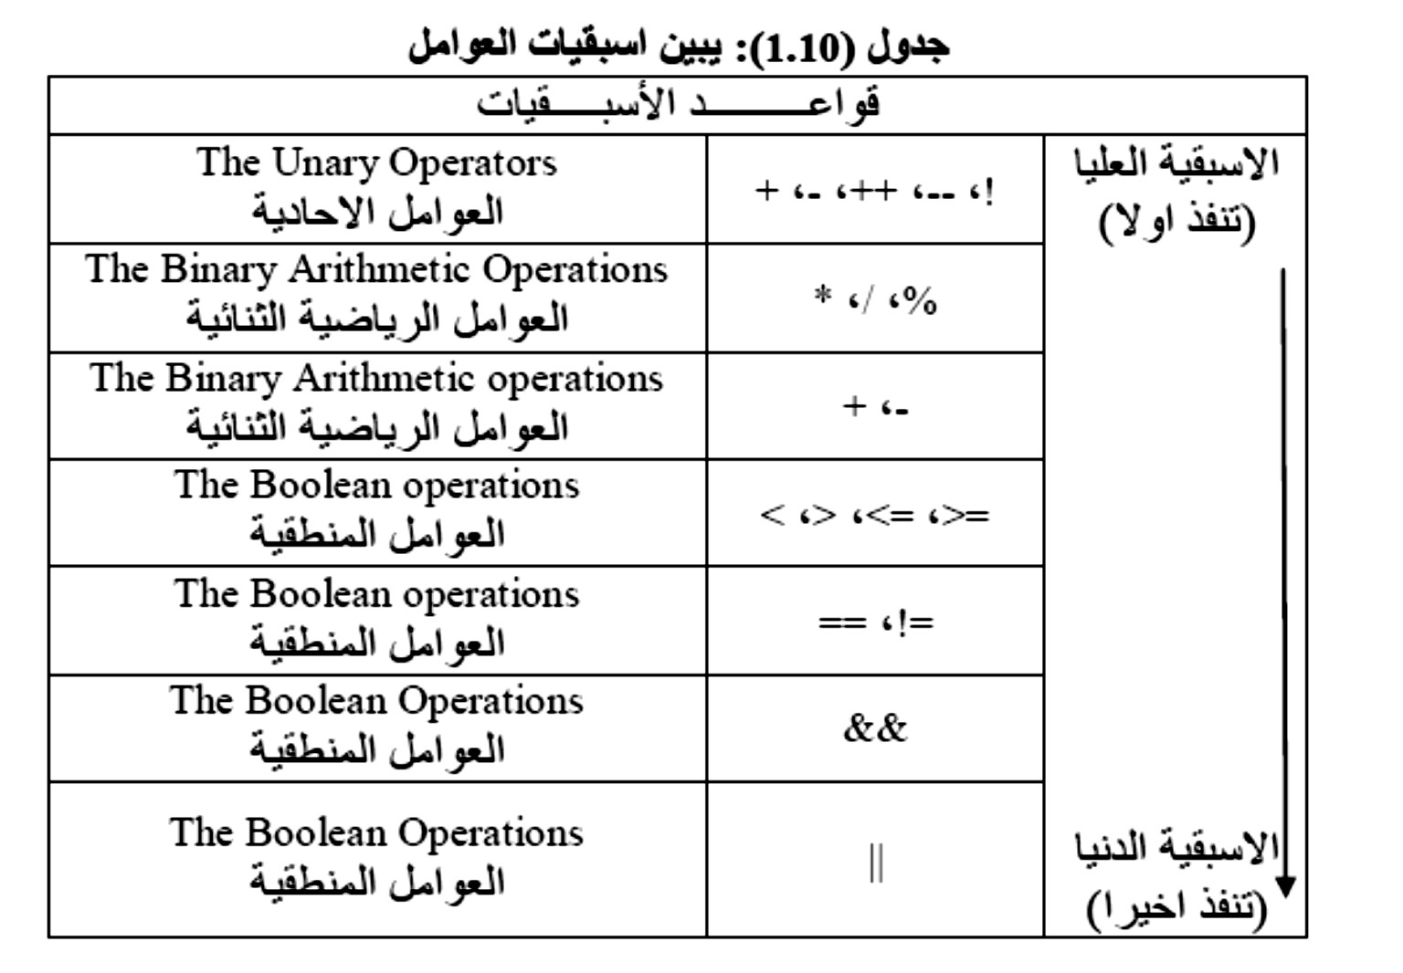
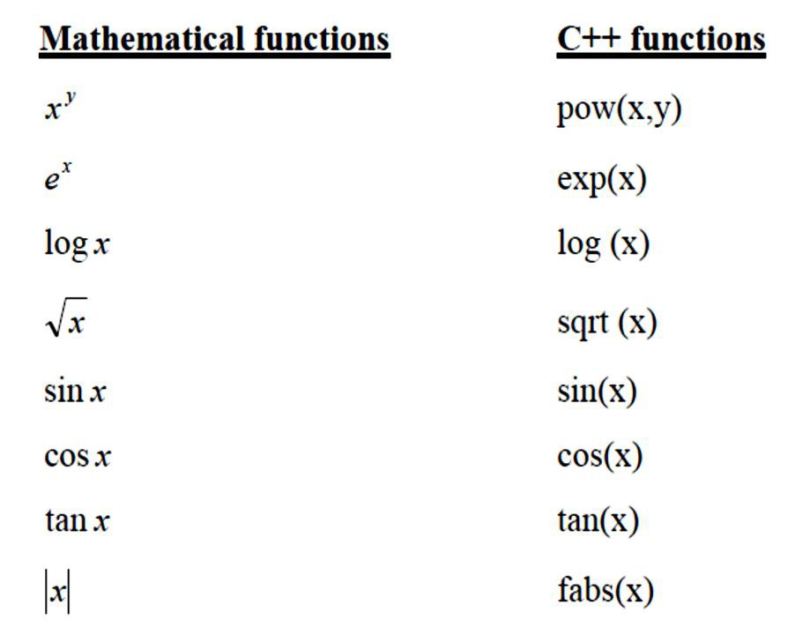
C++ lecture
Chapter two : Expression
Assistant lecture: Jinan N. Shihab
2.4 Mathematical library function (math.h):-
In case we want to use some of mathematical function like ( e^{x} , x^{y} ,log x,.......). In this case we must include the header file <math.h> in our program because these functions are defined
in that file, where the value of x is of type double.

Slide 14
C++ lecture
Chapter two : Expression
Assistant lecture: Jinan N. Shihab
Example: w.p.in C++ to compute and print the distance between two point (x1,y1) and (x2,y2) in Cartesian coordinates where:
Dis tance √(�� − ��)� + (�� − ��)�
# include <iostream.h>
# include <math.h> int main(){
int x1,x2,y1,y2; double distance;
cout <<"Input the value of x1,x2,y1,y2"<<endl; cin >>x1>>x2>>y1>>y2;
distance=sqrt (pow ((x1-x2),2)+pow((y1,y2),2));
cout <<"The distance is "<<distance<<endl; return 0;}
Example: w.p. in C++ to find the value of y from the expression below:
��� + ���� 𝐬𝐢𝐧��
√�
# include <iostream.h>
# include <math.h> int main() {
int x,b,z; double y;
cout <<"Input the value of x,b,z"<<endl; cin >>x>>b>>z;
y=((2*pow(x,2))+5*exp(3*x)*sin(6*b))/sqrt(z); cout <<"y= "<<y<<endl;
return 0;}
Example:- write C++ program to convert the (sec42200) to the corresponding in hours, minutes and seconds?
#include<iostream.h>
main() {
int sec =42200 % 60;
int temp =42200 / 60;

Slide 15
C++ lecture
Chapter two : Expression Assistant lecture: Jinan N. Shihab
int min =temp % 60; int hour = temp / 60;
cout<<"hour="<< hour<<" ,min="<< min<<" ,sec="<< sec; return 0;}
Example: W.P. in C++ which inputs a temperature reading expressed in Fahrenheit and output its equivalent in Celsius, using the
formula: � = ^{�(�−��)}
𝟗
#include <iostream.h>
int main()
{
double f, c;
cout << "Temperture in Fahrenhait:"; cin >> f;
c=5*(f-32)/9;
H.W:-
1- write C++ program to find the value Y of the equation a- Y=[(x-z)²-(x+z)]/32.
� �
_{b- � =} � −� � + �
��+��+�
₊ �
c- � = � − �
� �
�! �!
2- what is the computation sequence of the following expression:-
� + �
((� + �)/(� − �))/( ^{� − ��} )
�
If a=10, b=20, c=14, d=8, and e=40.
3- for each the following algebraic expressions write an equivalent C++ arithmetic expression:-
� �
� −�
)
)
3- ) � + �� + �
��+��
� ₊ � ₊ � ₊ �
�
�� �� ��
�
f- w.p. C++ expression for the following formula use functions from the math library described?
1- (sin x)² × (cos)²
�
_{2- ��}√����
(𝒍��( �� ))
3-
�−�
_{(�}�+�₎
4- � = �𝒊� � + �^{|�|+�} + ��.�

